Slide 1
Proposal Overview
HCI - Enterprise Cloud Proposal for
Rugged Rider Auto
Americas Team 42
April 12, 2018

Slide 2
Proposed Solution
Overview

Slide 3
Requirements description of current environment
Car dealerships and business throughout US West
25 business locations
Growing by 1 dealership per month
Each location requires own central parts ordering application consisting of:
NGINX and HAProxy load balancers
5x new non-persistent users
2x new full clone persistent desktops
Reduce
CAPEX
OPEX
70%+ TCO reduction
2. RAM: 1,700 GB provisioned, 950MB max used
3. Storage: 43TB provisioned, about 25TB used
4. Networking: 10GB minimum
5. Hypervisor: vSphere

Slide 4
Solution Sizing

Slide 5
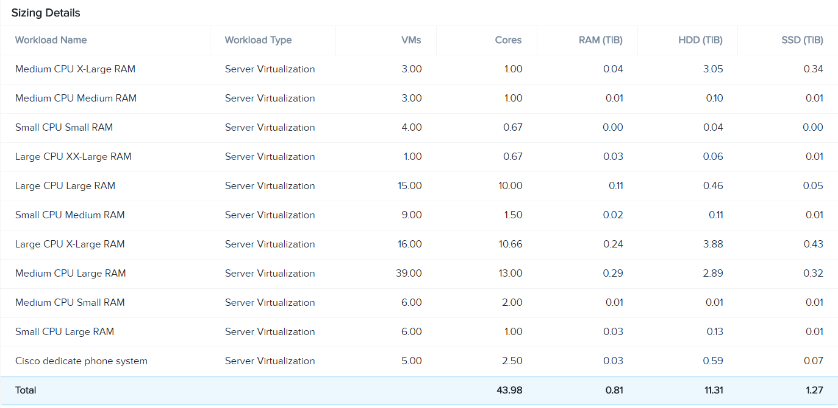
Solution Sizing

Slide 6
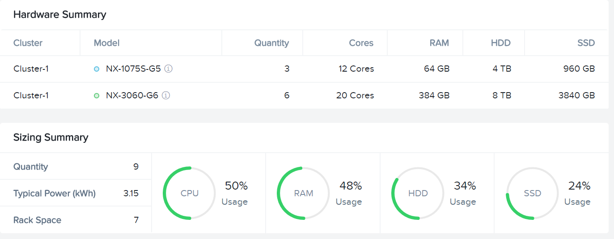
Solution Sizing

Slide 7
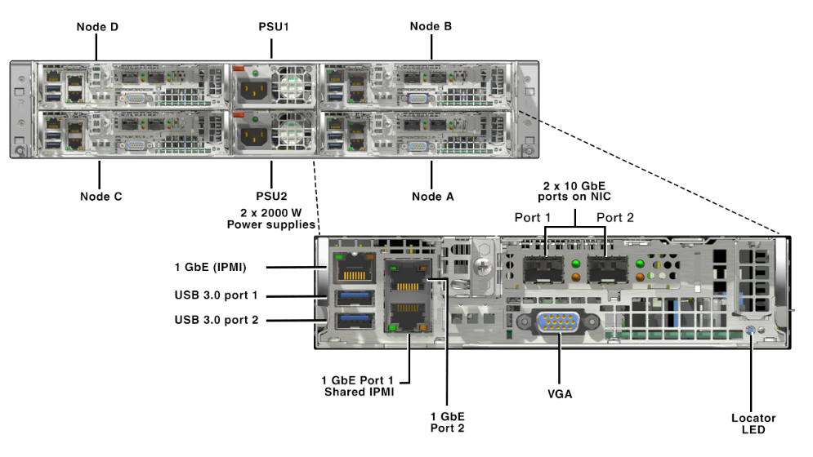
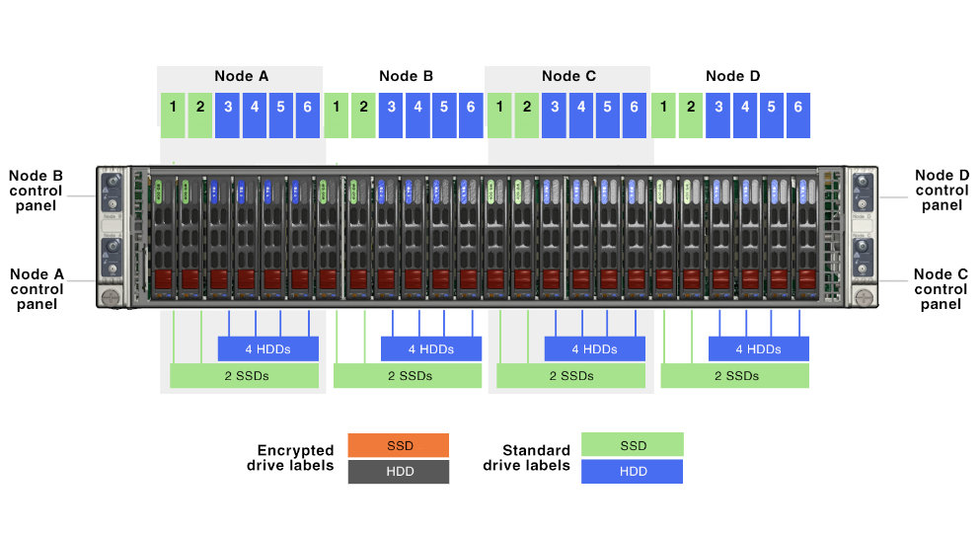
Proposed Cluster Physical Overview
BACK
FRONT
CLUSTER OVERVIEW
NX-3460-G6 NODE OVERVIEW

Slide 8
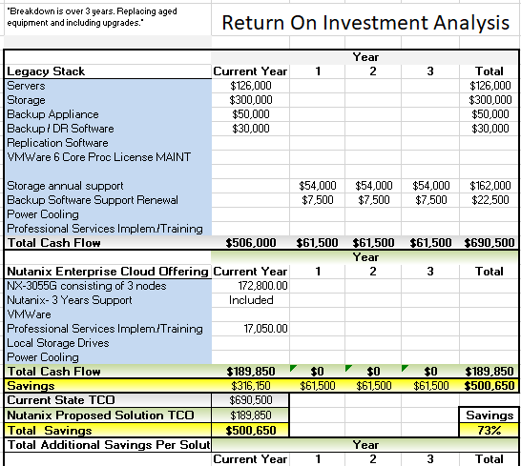
TCO Calculation
Product Code | Qty | Unit Price $ | Extended Price $
NX-3460-G6 (4 Nodes in a Block) | 4 | 43,200.00 | 172,800.00
Nutanix 3 years support 24 x 7 | 4 | Included | Included
Implementation Services |  |  | 17,050.00
Total |  |  | 189,850.00

Slide 9
Product and Support Overview

Slide 10
Acropolis Overview

Slide 11
Prism Overview

Slide 12
Support Tiers

